Slide 1
The Raft Consensus Algorithm
Originally by :Diego Ongaro John Ousterhout
Stanford University Edited using content from the paper as well.
http://raftconsensus.github.io

Slide 2
What is Consensus?
Agreement on shared state (single system image)
Recovers from server failures autonomously
Minority of servers fail: no problem
Majority fail: lose availability, retain consistency
Key to building consistent storage systems
Servers

Slide 3
Inside a Consistent System
TODO: eliminate single point of failure
An ad hoc algorithm
“This case is rare and typically occurs as a result of a network partition with replication lag.”
– OR –
A consensus algorithm (built-in or library)
Paxos, Raft, …
A consensus service
ZooKeeper, etcd, consul, …

Slide 4

Replicated State Machines
Clients
z←6
Consensus Module
State Machine
Consensus Module
State Machine
Consensus Module
State Machine
x | 1
y | 2
z | 6
x | 1
y | 2
z | 6
x | 1
y | 2
z | 6
Servers
Log
Log
Log
x←3
y←2
x←1
z←6
x←3
y←2
x←1
z←6
x←3
y←2
x←1
z←6
Replicated log ⇒ replicated state machine
All servers execute same commands in same order
Consensus module ensures proper log replication
System makes progress as long as any majority of servers are up
Failure model: fail-stop (not Byzantine), delayed/lost messages

Slide 5
Paxos Protocol
Leslie Lamport, 1989
Nearly synonymous with consensus
“The dirty little secret of the NSDI community is that at most five people really, truly understand every part of Paxos ;-).” – NSDI reviewer
“There are significant gaps between the description of the Paxos algorithm and the needs of a real-world system…the final system will be based on an unproven protocol.” – Chubby authors

Slide 6
Raft’s Design for Understandability
We wanted the best algorithm for building real systems
Must be correct, complete, and perform well
Must also be understandable
“What would be easier to understand or explain?”
Fundamentally different decomposition than Paxos
Less complexity in state space
Less mechanism

Slide 7
Raft Overview
Leader election
Select one of the servers to act as cluster leader
Detect crashes, choose new leader
Log replication (normal operation)
Leader takes commands from clients, appends them to its log
Leader replicates its log to other servers (overwriting inconsistencies)
Safety
How to keep log consistent even on leader crash. Could crash half way between log replication.
Only servers with uptodate logs can be leaders

Slide 8
Leader election
Time out (random numbers ) on not receiving any heart beat.
First server to time out will send out leader election requests.
If gets vote from majority then he considers himself as leader and starts sending heartbeat msgs For every heart beat received all reset their timeout value
Log replication
Client when wants to write sends to leader. Leader writes to its log Sends requests to other servers to write into log After replication done then marks that it can be used by state machine

Slide 9
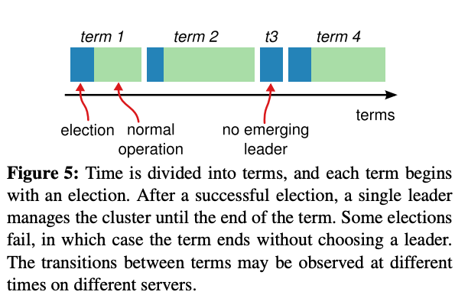
Terms
Detect obsolete leader. One term is for one leader. When leader crashes then next term. No global view of terms. Each server has his own understanding of term number. Updated when servers talk to each other and ensures he is follower if leader. If gets client request then he wont execute and just steps down.

Slide 10
Core Raft Review
Leader election
Heartbeats and timeouts to detect crashes
Randomized timeouts to avoid split votes
Majority voting to guarantee at most one leader per term
Log replication (normal operation)
Leader takes commands from clients, appends them to its log
Leader replicates its log to other servers
Built-in consistency check simplifies how logs may differ
Safety
Only elect leaders with all committed entries in their logs
New leader defers committing entries from prior terms

Slide 11
Leader Operation
Client sends request to leader
Leader appends to its log and sends it to followers to append
Once leader gets enough response from followers he then executes on his state machine and tells client. For next RPCS it also informs other followers who also executes on their SM.
Leader keeps connecting to followers till its done if follower crashes meanwhile Assumption: majority of servers always up.
Notes:
We only want to ensure that command is stored in majority logs of a follower. Eventually he will know that its committed either by the term leader of that time or even from a new leader.

Slide 12
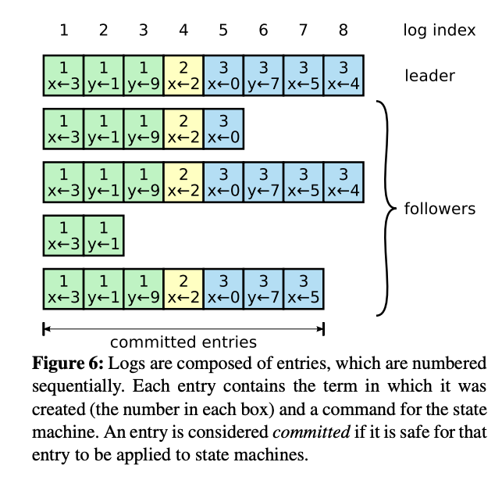
Log entries

Slide 13
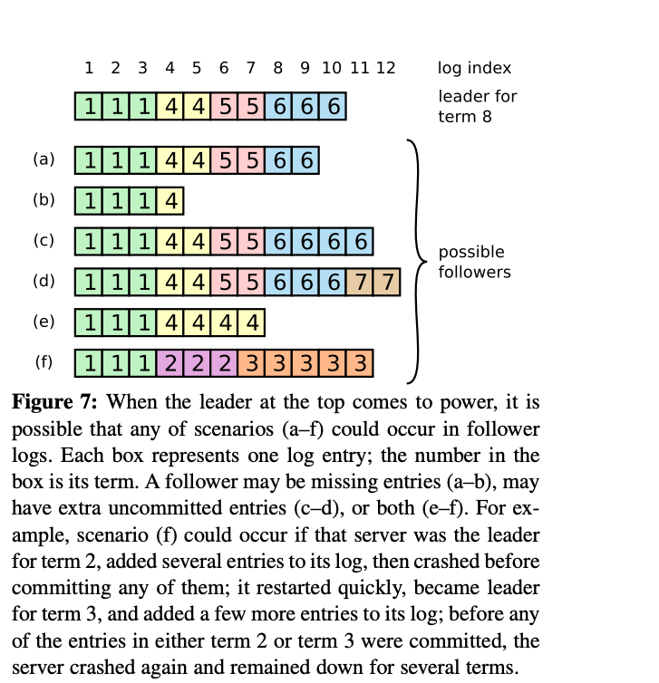
Inconsistencies: Can this happen?

Slide 14
Conclusions
Consensus widely regarded as difficult
Raft designed for understandability
Easier to teach in classrooms
Better foundation for building practical systems
Paper/thesis covers much more
Cluster membership changes (simpler in thesis)
Log compaction (expanded tech report/thesis)
Client interaction (expanded tech report/thesis)
Evaluation (thesis)

Slide 15
Questions
raftconsensus.github.io

